Slide 1
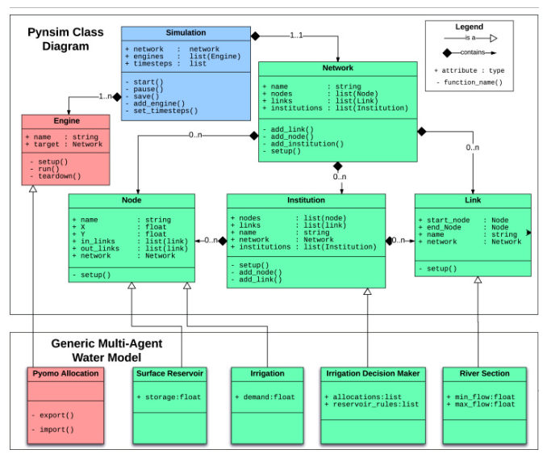
Pynsim Class Structure

Slide 2
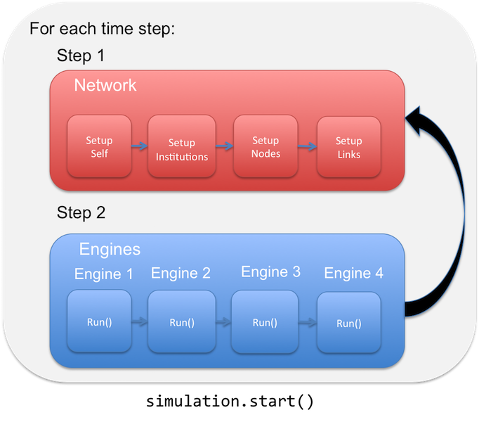
General Pynsim Model Sequence
Simulation setup
Add engines to simulation
Start simulation

Slide 3
Model Setup
M1. Define simulation options
M2. Define domain characteristics
M3. Setup pynsim simulation & landscape
M4. Initialize agents and buildings on landscape
M5. Define engines
Model Time Period (Year)
S1. Landscape setup – Refresh household queues
S2. New Agent Creation Engine – Creates new agents and adds to location queue
S3. Existing Agent Relocation Engine – Identifies relocating agents and adds to location queue
S4. Agent Location Utility – Samples available properties and calculates utility
S5. Housing Market Engine – Matches Buyers and Sellers
S6. Building Development Engine – Develops new buildings
S7. Landscape Statistics – Calculate various block group statistics

Slide 4
General Modes to Interrogate Results
Network history
Total population
Block group history
Total population
Average Income
No. of household agents
Household agent history
Location
Plot library

Slide 5
Simulation Setup (need to revisit)
s = ICOMSimulator() - Create pynsim simulation object, s
s.set_timestep_information() – Add timesteps to simulation, s.timesteps
s.set_landscape() – Add landscape/network to simulation, s.network
s.network.add_institution(CountyZoningManager()) – Add example zoning agent, s.network.get_institution(‘005’)
s.network.add_institution(RealEstate()) - Add real estate agent
s.network.add_institution(AllHHAgents(name='all_hh_agents’)) – Add categorical institution that contains all household agents, s.network.get_institution(‘all_hh_agents’)
s.convert_initial_population_to_agents() – Convert initial population to household agents, s.network.get_institution(‘all_hh_agents’).components
s.initialize_available_building_units() – Sets initial vacancy level on landscap (20%) bg.available_units
Exclude in toy model
Need to implement

Slide 6
Add Engines to Simulation (need to revisit):
s.add_engine(RealEstateAssessment()) – Real estate agent performs hedonic analysis on the market (TO IMPLEMENT)
s.add_engine(NewAgentCreation()) - Creates new household agents based on population growth assumptions and adds them to the unassigned queue, s.network.unassigned_hhs (NEW AGENT RATE, HH CHARACTERISTICS?)
s.add_engine(ExistingAgentReloSampler()) – Identifies existing household agents that want to re-locate and adds them to the relocating queue, s.network.relocating_hhs (HOW TO IDENTIFY AGENTS THAT WANT TO MOVE?)
s.add_engine(HousingInventory()) – Determines the housing inventory available for each block group, s.network.available_units_list – DEPRECATED (now use Pandas DF)
s.add_engine(NewAgentLocation()) – For each agent in s.network.unassigned_hhs sample 10 available properties and calculate utility, example_hh_agent.hh_utilities (DETERMINE # OF UNITS AGENTS SAMPLE, MODULARIZE UTILITY CALC)
s.add_engine(ExistingAgentLocation()) – For each agent in s.network.relocating_hhs sample 10 available properties and calculate utility, example_hh_agent.hh_utilities – (DETERMINE # OF UNITS AGENTS SAMPLE, MODULARIZE UTILITY CALC)
s.add_engine(HousingMarket()) – Matches agents in s.network.unassigned_hhs and s.network.relocating_hhs with top properties.
s.add_engine(FloodHazard()) – Flood hazard module runs (PLACEHOLDER)
s.add_engine(Zoning()) – Zoning engine runs (PLACEHOLDER)
TBD Engines:
s.add_engine(RealEstate())
s.add_engine(FloodHazard())
s.add_engine(Zoning())

Slide 7
Market Mechanism Concept (based on RHEA):
Sellers decide to sell property (hh-sellers) ^{(a)}
Realtor determines coefficient of hedonic function, i.e., price as function of home attributes (realtor)
Sellers set ask price based on hedonic function (hh-sellers) ^{(b) (c) (d) (e)}
Buyer samples N spatial goods among affordable ones (hh-buyers) ^{(f) (g)}
Buyer ranks the list of N goods according to utility (hh-buyers) ^{(h)}
Buyer calculates WTP for N goods (hh-buyers)
Sellers evaluate the offers and select the highest (hh-sellers) ^{(i)}
Market iterates until all hh-buyers register a trade (market)
The actual annual number of houses going for sale is a random number generated from the normal distribution based on these two. In the future versions of the model this number could be made endogenous. Secondly, households that reside within a flood zone may choose to put their house on sale and look for a home in a safer location, which according to our survey data is more likely to happen when they have experienced a flood. As the simulation goes on, settled households may decide to relocate.
At the beginning of a trading period active sellers announce their ask prices. This is done by combining hedonic regression on housing transactions with spatial interpolation (kriging) of the residuals of the regression. Following de Koning et al. (2016), hedonic regression is run with only a few of the main housing attributes: square footage, acreage, age, number of bedrooms and flood zone location. The residuals of the regression represent most of the location-specific attributes associated with the market value of a property, which is then interpolated over space using kriging.
On top of hedonic analysis and kriging, the algorithm that forms sellers’ ask price takes into account the demand for a segment of a market in the previous time step. For each property, the realtor checks the demand for a group of properties with the same characteristics. The observed demand for these properties relative to the expected demand (at time t-1) determines if the price should be lowered or raised (at time t).
All households in town (homeowners and buyers) update their experience with flooding – a binary true/false variable – after the floods. Housing prices reduce in anticipation of a drop in demand for properties in the flood zones. To capture this in the model, the flood affected sellers reduce their price by 13.8%, and sellers in the 100 year flood zone reduce their price by an additional 15.7% (empirically observed in the survey among sellers).
Homeowners that do have a mortgage will pay off their mortgage linearly in 30 years. This is another important aspect of the model, because it determines whether homeowners are capable of selling their house. If the expected price of their property on the market has dropped below their mortgage debt, for example as a result of a major flooding event, they will abolish their trade attempt. These traders are identified as ‘stuck’ in their homes.
Each time step a number of new buyers enter the market, approximately equivalent to the number of new properties on sale to avoid creating an excess of demand or supply artificially. Buyers randomly choose five properties affordable for their housing budget which varies across households. Insurance influences buyers’ decisions first in this phase. In the model with 100% insurance uptake, buyers limit their budget for properties in the flood zone to reserve fund for insurance costs
Buyers have subjective perceptions of risk, which are dynamic over time. Their risk perception variables determine whether buyers avoid buying properties in the 1:100 and 1:500 year reoccurring flood zones. This affects the demand for risk-prone properties.
Their utility for owning a property depends on a bundle of property attributes, neighborhood quality and a potential exposure to flood hazard. The base multi-attribute utility function (U0L, Eq.4.1) for a house in a safe area is parameterized using weights (Ai) that reflect relative importance of each characteristic (Xi,norm): 𝑈_{0𝐿}=𝐴_{𝑖}∗𝑋_{𝑖,𝑛𝑜𝑟𝑚}
The transaction price is defined through a price negotiation procedure, which is based on bid and ask prices and relative market power of traders

Slide 8
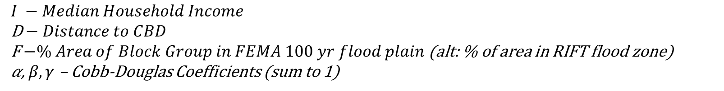
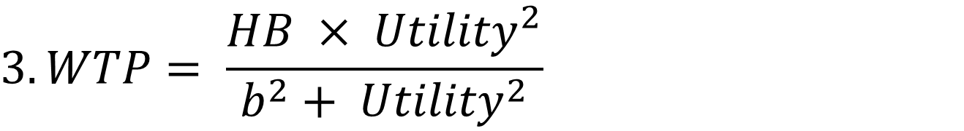
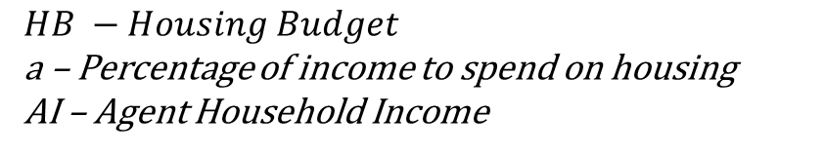
Simple Household Cobb-Douglas Utility Function:
$$1. HB=a ∗AI$$
$$HB −Housing Budget$$
a – Percentage of income to spend on housing
AI – Agent Household Income
$${2. Utility}_{agent, bg}= I^{α}×D^{β}×F^{γ}$$
$$I −Median Household Income$$
D$− Distance to CBD$
F$−\% Area of Block Group in FEMA 100 yr flood plain$ (alt: % of area in RIFT flood zone)
𝛼, $β, γ$ – Cobb-Douglas Coefficients (sum to 1)
$$3. WTP= \frac{HB × {Utility}^{2}}{b^{2}+ {Utility}^{2}}$$
$$WTP −Willingness to Pay$$
b – WTP Coefficient

Slide 9
Working Hypothesis / Title: Structural uncertainty dominates parametric uncertainty in modeling of flood-prone housing markets
Parametric Uncertainties:
Housing budget percentage
Coefficients of household buyer’s utility functions
Coefficients of the willingness to pay function
Structural Uncertainties:
Functional form of the housing budget
Functional form of the utility function
The attributes included in the utility function (e.g., housing structure attributes versus neighborhood characteristics)
Functional form of the willingness to pay function
Other Uncertainties:
Structure / sequencing of the negotiation process between buyers and sellers (e.g. when and how ask/bid prices are formed? how are final transaction prices determined? etc…)
# of agents that decide to sell property
Interface with the flood hazard (see previous slide)
# of available properties that a buyer agent considers during home search

Slide 10
Working Hypothesis / Title: Structural uncertainty dominates parametric uncertainty in the evolution of coupled human-flood housing markets
Focus specifically on coupled human-flood interactions
3 Structural Variants to represent Structural Uncertainty:
Some risk-adverse agents are predisposed to avoid flood zone entirely
Agents incorporate flood risk as a disamenity in their utility function
Agents incorporate flood insurance into housing budget but otherwise neglect flood risk
Parametric Uncertainties Associated w/ each:
Percentage of households who are risk-adverse
The coefficient for the flood risk disamenity factor
The percentage of income

Slide 11
Working Hypothesis / Title: Structural uncertainty dominates parametric uncertainty in urban development trajectories of flood-prone housing markets
How does flood risk interface with our agents in the toy model? Some options…
The occurrence of floods:
Exogenously imposed for a specific year
Treat stochastically
The impact of floods:
Based on FEMA 100-year flood plain - binary flooded or not-flooded
Based on RIFT simulation for a particular event (e.g., 6-hour, 100-year flood) – depth per grid cell
Based on stochastically-forced RIFT simulations – depth per grid cell
How does this occurrence/magnitude of flooding relate to “F” in our agent’s utility functions?
The flooding coefficient (γ) is held constant and uniform across agents
Only certain agents include flooding (F) in their utility function or coefficient (γ) differs across population
The flood coefficient (γ) in the utility function increases after the incidence of a major flood, then decreases as the memory of the flood fades
Agents have an increasing likelihood of selling a flood-exposed property after the occurrence of a flood

Slide 12
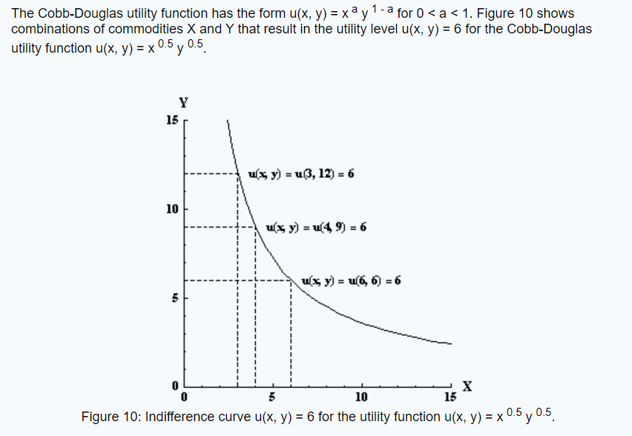
Simple Household Cobb-Douglas Utility Function:

Slide 13
2 topics to cover:
Aggregating flood risk at the block group level
Design of experiments to interrogate structural vs. parametric uncertainties

Slide 14
Aggregating flood risk at the block group level w/
MS Buildings Footprints
~274,000 buildings identified in study area

Slide 15
Building
Count
per
Block
Group

Slide 16
RIFT
Flooding

Slide 17
Identify % of Flooded Buildings
(> 6-in during 100-year event)

Slide 18
Simple Household Cobb-Douglas Utility Function:
$$1. HB=a ∗AI$$
$$HB −Housing Budget$$
a – Percentage of income to spend on housing
AI – Agent Household Income
$${2. Utility}_{agent, bg}= I^{α}×D^{β}×F^{γ}$$
$$I −Median Household Income$$
D$− Distance to CBD$
F$−\% Area of Block Group in FEMA 100 yr flood plain$ (alt: % of area in RIFT flood zone)
𝛼, $β, γ$ – Cobb-Douglas Coefficients (sum to 1)
$$3. WTP= \frac{HB × {Utility}^{2}}{b^{2}+ {Utility}^{2}}$$
$$WTP −Willingness to Pay$$
b – WTP Coefficient

Slide 19
Simple Household Cobb-Douglas Utility Function (alternate utility function):
$$1. HB=a ∗AI$$
$$HB −Housing Budget$$
a – Percentage of income to spend on housing
AI – Agent Household Income
$${2. Utility}_{agent, bg}= I^{α}×D^{β}×F^{γ}$$
$$I −Median Household Income$$
D$− Distance to CBD$
F$−\% Area of Block Group in FEMA 100 yr flood plain$ (alt: % of area in RIFT flood zone)
𝛼, $β, γ$ – Cobb-Douglas Coefficients (sum to 1)
$$3. WTP= \frac{HB × {Utility}^{2}}{b^{2}+ {Utility}^{2}}$$
$$WTP −Willingness to Pay$$
b – WTP Coefficient

Slide 20
Working Hypothesis / Title: Structural uncertainty dominates parametric uncertainty in modeling of flood-prone housing markets
Parametric Uncertainties:
Housing budget percentage
Coefficients of household buyer’s utility functions
Coefficients of the willingness to pay function
Structural Uncertainties:
Functional form of the housing budget
Functional form of the utility function
The attributes included in the utility function (e.g., housing structure attributes versus neighborhood characteristics)
Functional form of the willingness to pay function
Other Uncertainties:
Structure / sequencing of the negotiation process between buyers and sellers (e.g. when and how ask/bid prices are formed? how are final transaction prices determined? etc…)
# of agents that decide to sell property
Interface with the flood hazard (see previous slide)
# of available properties that a buyer agent considers during home search

Slide 21
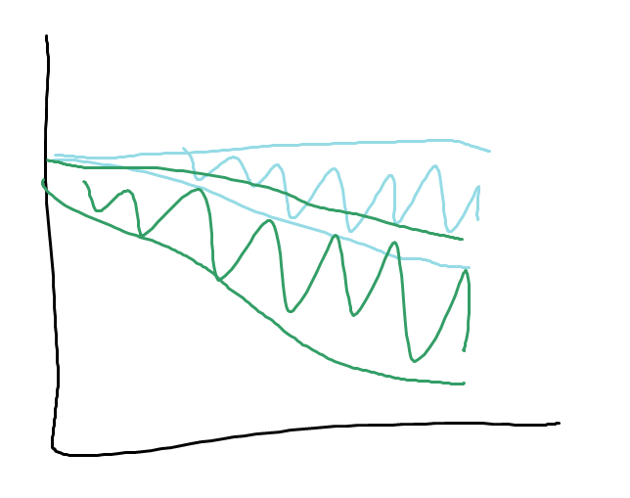
Working Hypothesis / Title: Structural uncertainty dominates parametric uncertainty in the evolution of coupled human-flood housing markets
Focus specifically on coupled human-flood interactions
1. Avoidance: Risk averse agents avoid
flood zone entirely
2. Disamenity: Agents incorporate flood risk as disamenity in utility function
3. Insurance: Agents incorporate flood insurance in housing budget
3 structural variants
% of households that avoid flood plain
Coefficient for flood risk disamenity, γ
Annual cost flood insurance as % of mortgage
n parametric variants
per structural variant
% = 20
% = 30
…
% = 80
γ = 0.1
γ = 0.2
…
γ = 0.8
% = 5
% = 6
…
% = 20
Avg Home
Price in Flood
Zone
Illustration of result
Model Year

Slide 22
Household Utility Function
Structural:
Square footage – Zillow, static
Year Built – Zillow, static
Bathrooms – Zillow, static
HouseAve? – Zillow, static
Environmental:
Flood Risk – RIFT, static
Distance to CBD – GIS, static
Neighborhood:
Median Household Income
Restaurants (CNS18)
How should we handle?

Slide 23
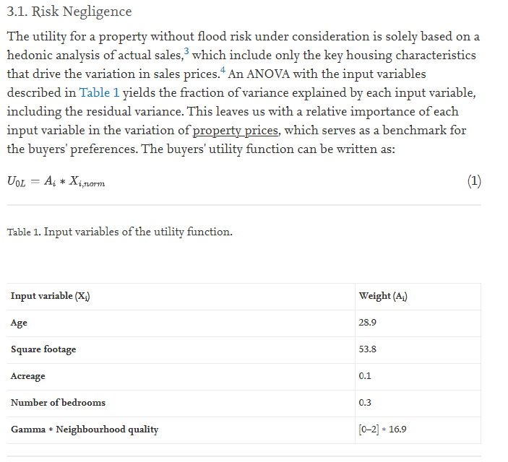
From de Koning, Filatova, & Bin:

Slide 24
Initialize model:
Block Group (or blocks) – Average Home Price (Zillow), Available Units (?), Average HH Income (U.S. Census), Average Household Size (U.S. Census), Distance to CBD (proximity), CNS or CNS score (U.S Census and proximity)
Agents (aggregated x10 or x100 at Block or BG) – Income (U.S. Census – distribution or uniform?), Housing Budget (percentage of income), Household Size (U.S. Census – distribution of uniform?)
Flood risk “score” calculated for each BG or block by intersecting RIFT flooding output with MS buildings footprint.
Growth and Relocation assumptions (supply-constrained, growing market):
1 percent population increase each time period (1 year) – higher income population
5 percent building stock increase each time period (if there was sufficient demand) up to maximum urban density
10 percent of residents randomly decide to relocate

Slide 25
Working Hypothesis / Title: Structural uncertainty dominates parametric uncertainty in the evolution of coupled human-flood housing markets
Focus specifically on coupled human-flood interactions
1. Avoidance: Risk averse agents avoid
flood zone entirely
2. Disamenity: Agents incorporate flood risk as disamenity in utility function
3. Reactive: Agents leave/avoid flood zone after major events
3 structural variants
% of households that avoid flood plain
Coefficient for flood risk disamenity, γ
% of households that avoid flood plain
n parametric variants
per structural variant
% = 20
% = 30
…
% = 80
γ = 0.1
γ = 0.2
…
γ = 0.8
% = 5
% = 6
…
% = 20
Avg Home
Price in Flood
Zone
Avg Income in Flood
Zone
Illustration of result
Model Year

Slide 26
Working Hypothesis / Title: The effect of spatial resolution and agent aggregation on the modeling of coupled human-flood housing markets.
Focus specifically on coupled human-flood interactions
1. Avoidance: Risk averse agents avoid
flood zone entirely
Choose 1 (or multiple
structural variants
Spatial res: Block group
Agent agg: 100 hh’s
Spatial res: Block
Agent agg: 100 hh’s
Spatial res: Block group
Agent agg: 10 hh’s
Spatial res: Block
Agent agg: 10 hh’s
Structural Variants
Avg Home
Price in Flood
Zone
Illustration of result
Model Year

Slide 27
